Slide 1
The Art of Technology
info@artezio.com
www.artezio.com

Slide 2
About us
OVER
1000
PROJECTS
20
YEARS ON THE MARKET
Artezio is an ISO 9001:2015 certified software development company. Since establishment in 2000, Artezio has completed over 1000 projects for its international corporate customer base, thus the Company has become one of the key players on the European/US software development outsourcing market.

Slide 3
Staff Matrix
TECHNOLOGIES
RESOURCE NAME
NUMBER OF RESOURCES
SERVICES
RESOURCE NAME
NUMBER OF RESOURCES
Java
Java Developer
90+
Designer
Designer
3
.Net
.Net Developer
40+
DBA
DBA Developer
5
PHP
PHP Developer
20+
JavaScript
JavaScript Developer
90+
Testing
QA Engineer
40+
Salesforce
Salesforce Developer
4
Support
DevOps
1
Android
Android Developer
4
Business Analysis
Business Analyst
20+
iOS
iOS Developer
4
Python
Python Developer
70+
Project Management
Project Manager
20+

Slide 4
Company Overview
Established in 2000
Development centers in Belarus (Minsk, Vitebsk, Mogilev)
Sales and Operations Office in the US (New Jersey)
ISO 9001:2015 certified
Operations in Europe, North America, Middle East and JAPAC
Over 1000 successfully accomplished projects worldwide

Slide 5
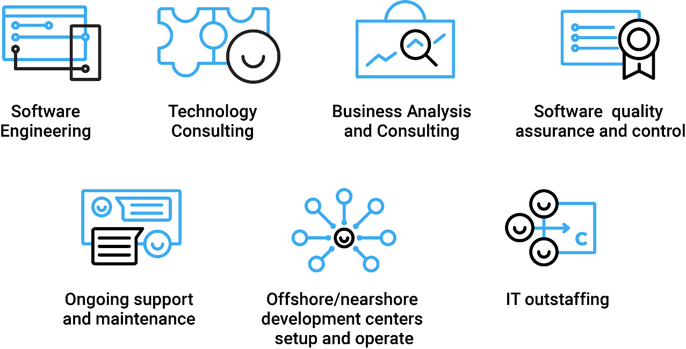
Artezio Services

Slide 6
Technology Profile
Web development
Mobile development
Rich Internet application (RIA) development based Java, ASP.NET, PHP, JavaScript and Python technologies
Development of sophisticated interfaces based GWT, Angular.JS, React.JS, Ext JS frameworks and Kendo UI components
Mobile friendly WEB application development
Single page application development
Whole stack of native Android, iOS and Win8\10 development technologies
Cross platform development (Apache Cordova, Xamarin, Telerik Platform)
Sophisticated geotracking app development
Three-tier solutions development

Slide 7
Technologies
Enterprise application development
Business process automation software based different BPM engines (Activiti BPM, jBPM)
High loaded based SOA system development using both whole JEE stack (CDI, EJB, JPA, JSP, JSF, JMS, SOAP, REST) plus related frameworks(Spring, Seam) and whole .Net stack (ASP.Net MVC, WPF, WCF)
Portal solutions based on Liferay Portal , Sharepoint WSS/MOSS, WebLogic Portal, WebSphere Portal
Integrations solutions using ESB (OSB, Oracle ESB, IBM WebSphere ESB, JBoss ESB), Spring integration, MSMQ, eMule
System based reporting Jasper, BIRT, Pentaho, SQL Server Reporting Services
Large, distributed systems and highly-scalable network servers using GoLang
Cloud based solutions (Azure, Amazon)
Big Data related technology
Database analysis and BI (Pentaho, Oracle BI)
NoSQL databases (Cassandra, MongoDB, CouchDB)
Search engines (Elastic search, Apache Solr, Sphinx)
Intellectual Data Processing (Apache Lucene, Apache Mahout)
Distributed Compilation (Apache Hadoop, Apache ZooKeeper)

Slide 8
R&D
Semantics
Big Data
semantic self-learning algorithms and NLP-based data processing tools to analyze large amounts of unstructured content (websites, emails, and documents)
storage and processing architecture
Image Recognition
Machine Learning
using Deep Learning Convolutional Artificial Neural Networks
pattern recognition based on logic, metrics, statistical and deep learning algorithms

Slide 9
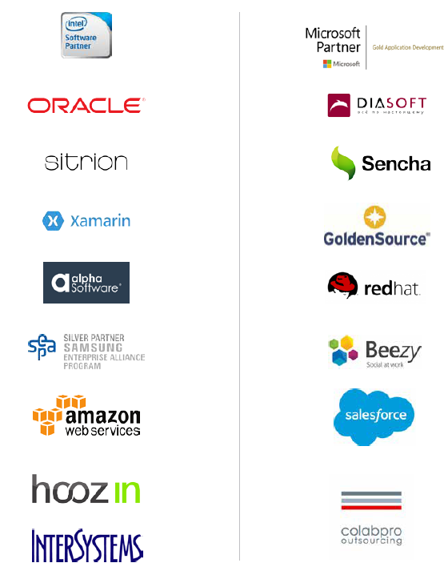
Business Partners
Artezio established solid relationships with industry leaders. Our goals are to follow best practices, to be on the forefront of newest technologies, to acquire technology expertise directly from the leaders, and to take advantage of vendors & certification.

Slide 10
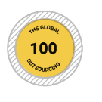
Company Awards
Artezio is included into Software Magazine’s Software 500 ranking of the world’s largest software and services providers in 2010-2016.
Artezio has been included into the main list of the IAOP
Global Outsourcing 100 in 2010-2013, 2015-2018
Best Rising Stars in:
Artezio is among 10 Central and Eastern European (CEE) software outsourcing leaders according to Gartner's top 30 locations for offshore services.
Healthcare
Telecommunications
Artezio is among 100 best outsourcing companies according to the Global Services 100 rating by NeoIT in 2011 and 2013.
Financial Services
Research & Development
Services Information / Comm. Technology Services;
No. of Centers worldwide.
Best Rising Stars by Region Served:
Western Europe
Artezio ranked #6 in the Black Book of Outsourcing among TOP 10 ITO Offshore: Eastern/Central Europe 2006.
Best Rising Stars by Region Served:
USA
Included into the Leader Matrix in Java, Web and QA according to the Clutch.co innovative research company in 2015-2020
Inc. 5000 List of Europe’s Fastest-Growing Companies 2018

Slide 11
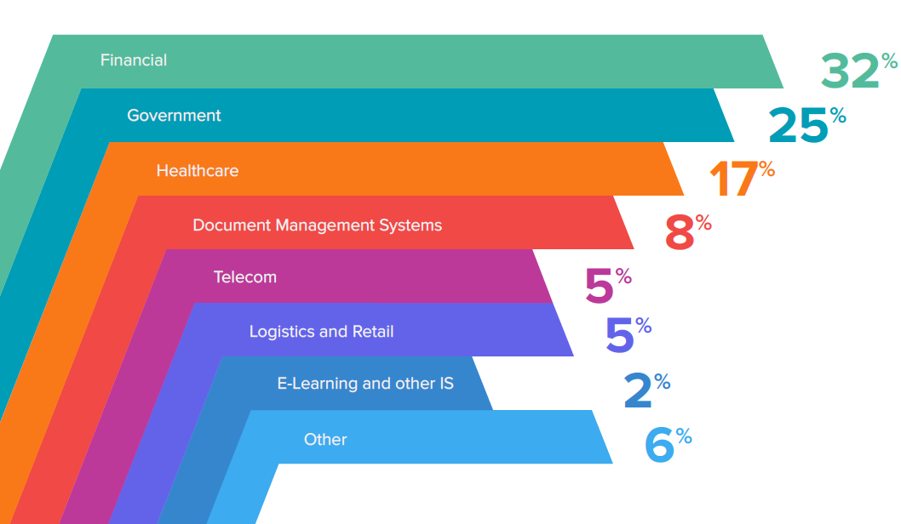
Industries

Slide 12
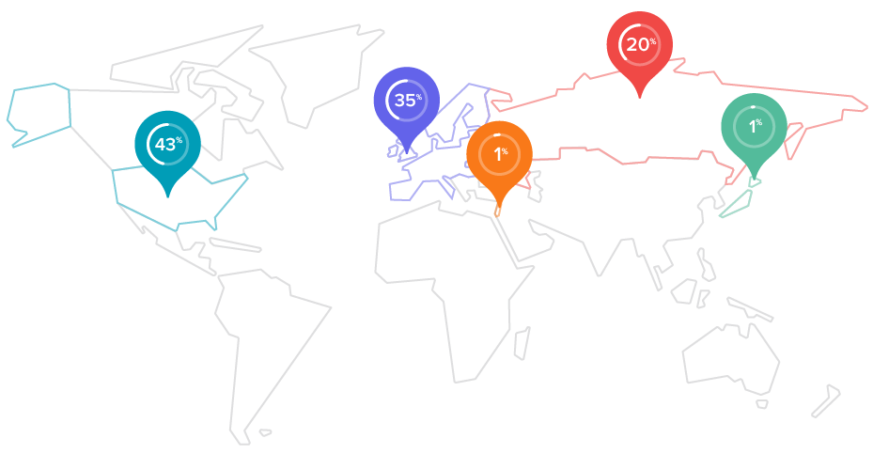
Clients Locations
Artezio provides IT services to companies from the United States, Western Europe, Israel and Japan

Slide 13
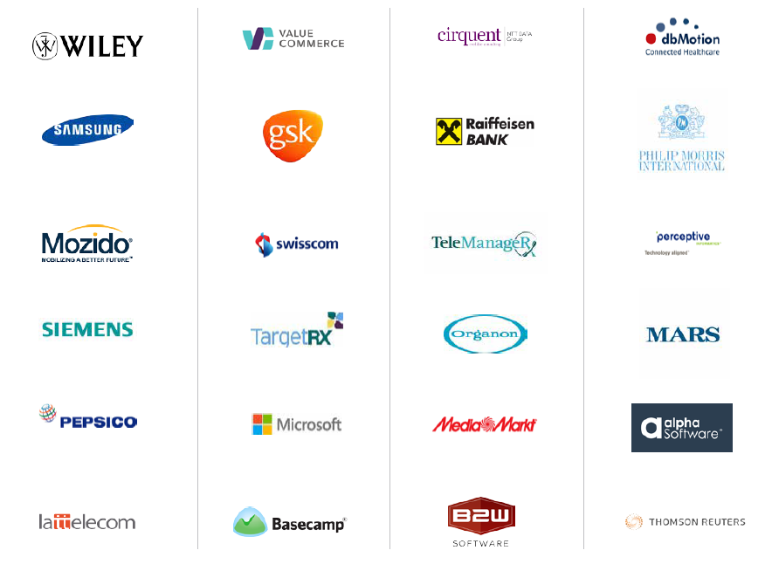
Featured Clients

Slide 14
Artezio Advantages
Deep industry domains expertise: Financial, Technology (internet and ISVs), Pharmaceutical and Healthcare
Over 1000 successful projects delivered and confirmed by customer references
Low attrition rate (8-10% annually) and high scalability because of multiple locations
Quality assurance and control confirmed by ISO 9001:2015 certificate
Investment in R&D activities - 12% of company turnover
In-house mobile and SaaS products
Over 90% certified software engineers
Financial stability

Slide 15
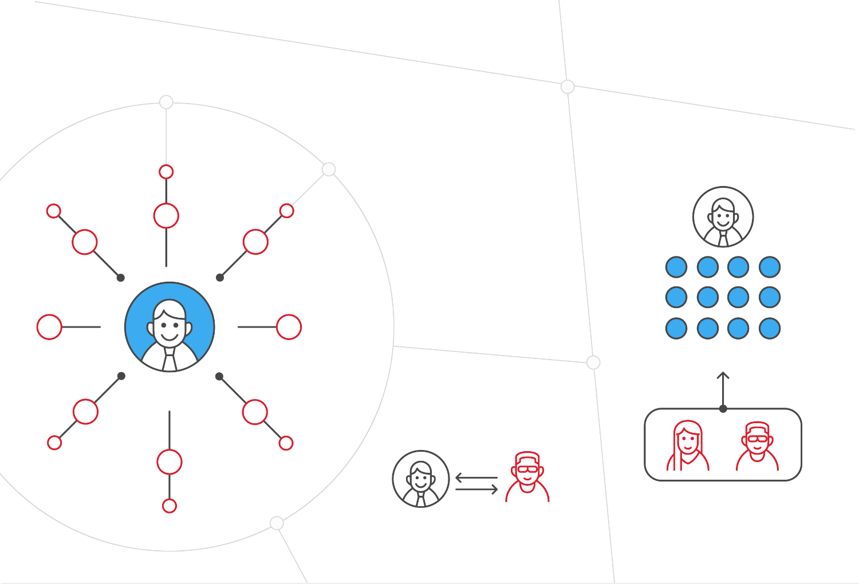
Business Models
Outstaffing
Dedicated development center
Client
Client
Outsourcing
Client
Artezio
2019 Artezio
artezio_software
info@artezio.com

Slide 16
Engagement Models
Fixed Price
Time & Materials
Mixed Model

Slide 17
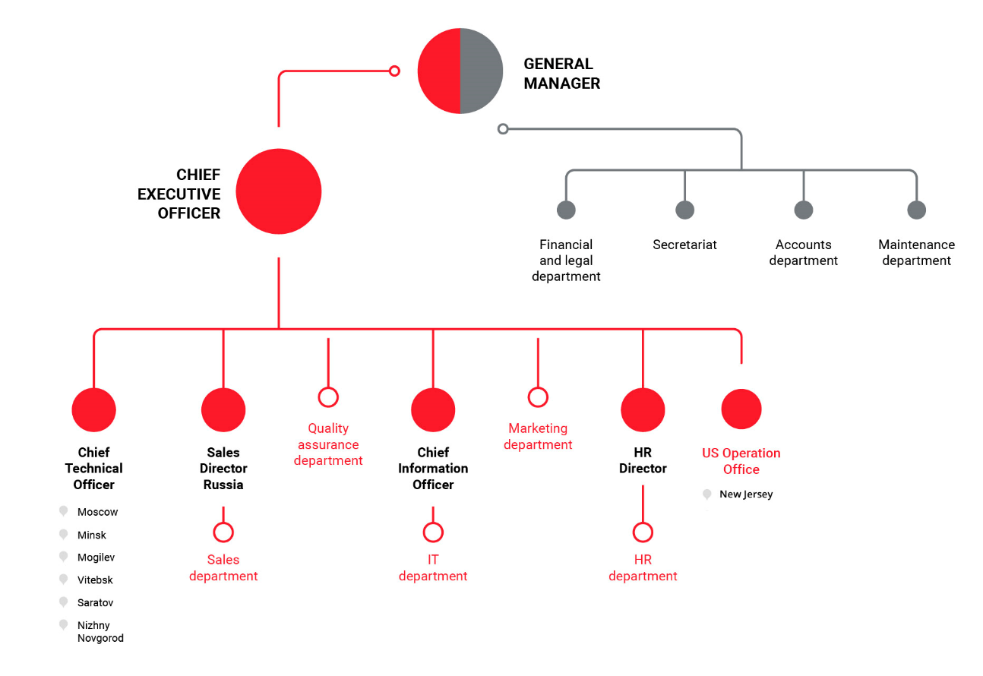
Organization Chart

Slide 18
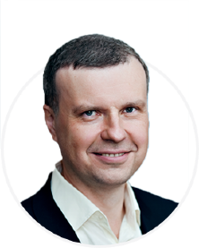
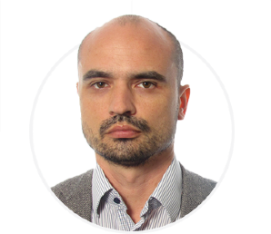
Management Team
Alexander Izosenkov
Pavel Adylin
Sergey Pavlov
GM and CFO
CEO
CTO
From its early days, Artezio has gone a long way from a small start-up to an internationally recognized brand with a wide client base and over 400 employees. Today, Artezio is a company with a sound revenue that duly meets its liabilities.
Together we work to make sure Artezio achieves our Mission to consistently deliver high-quality software solutions and IT consulting services to our clients.
Our world class leadership team consists of only high experienced professionals who know and understand key managing principles and technology basics leading the company to success and prosperity.

Slide 19
artezio_software
info@artezio.com

